Slide 1
Araneae Builders

Slide 2
ABOUT US
Group of 4 Freelancers building websites and helping the clients to expand their businesses

Slide 3
Existence on the WEB
Career Support Website
Geyser Product
https://www.lodestar.guru/
https://www.geyserservice.com/
IT solutions
BookShookgo
https://zeesense.com/
C:\Users\sopujari\Downloads\BookShookGo.mp4

Slide 4
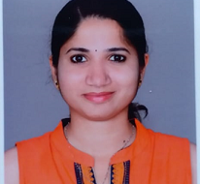
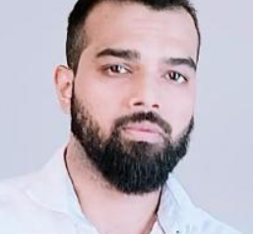
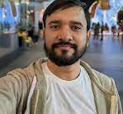
MEET THE TEAM
Sonali Pujari
Vyankatesh K
Kant Agarwal
Sanket K
Operations
Senior Developer
UI/UX Designer
Developer

Slide 5
THANK YOU
Sonali Pujari
+919900590144
sonalipujari1994@gmail.com

